Slide 1


Python Webapp Programming
Questionnaire app with Django
--Function view, with session

Slide 2
Design requirements of how user participate the questionnaire
One ask_for_name page, when user click start participate the questionnaire, this will be the first.
One voting is for doing the question form, one by one.
One voted is for finished all questionnaire, giving summary to the user.
After finished all questions, show the summary 5 seconds then refresh user to homepage. (need add JavaScript code)
If a user key in participate URL directly not starting from the beginning, redirect the user to first page, ask for user name.

Slide 3
Session, user, cookie
Cookie is a method of keeping data. Server gives cookie data and Browser need keep it in every request so that server can read it.
Session is not necessarily attached with specific user. After user authenticate success then this user is a session.
Three items here:
Session, User, Cookie.
Typical senarios:
Not login, fresh browser with no cookie, start browsing
Server record a session. Send to browser cookie data and keeps the session_id. Browser should accept cookie data and use in any further requests. Each time user add one item will add the server side session_data
Server record user_id in cookie data and possibly next time no need login again if cookie not expire.
Session_data moved to under user_account (shopping cart items moved into user_account so next time user comes again all item still there). The session was attached with a specific user, so every further action of this session will be reflected to the user account data.
Then user login
If user not login and close browser
After silent for certain time server removes session, invalid the cookie and session. If user comes back again start like fresh new.
If user login and then close browser
After silent for certain time server removes session.
But data modified in user_account remains. Cookie data of user normally has a expire time of many days.

Slide 4
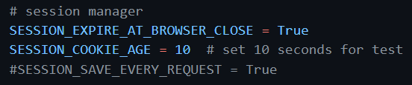
Add Session settings
When browser close, session will expire and browser will invalid the cookie
When session more than 10s no activities, session will expire, browser will invalid the cookie
The SESSION_SAVE_EVERY_REQUEST, will save session data on every request even the session data did not change. Normally does not need it.

Slide 5
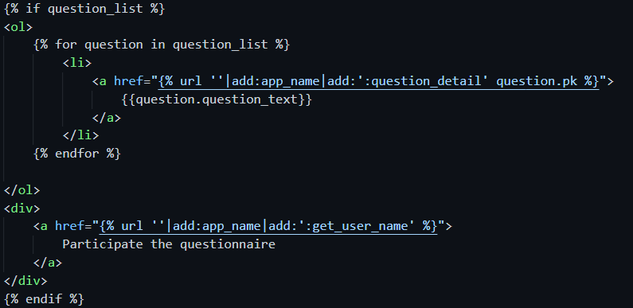
Add one button in homepage to start answering questionnaire
Add a link, which will start answer the questionnaire when clicked. (ask for user name as the first step if user is first time answering all questions.)

Slide 6

url conf
QuestionApp/urls.py, config for new url handling

Slide 7
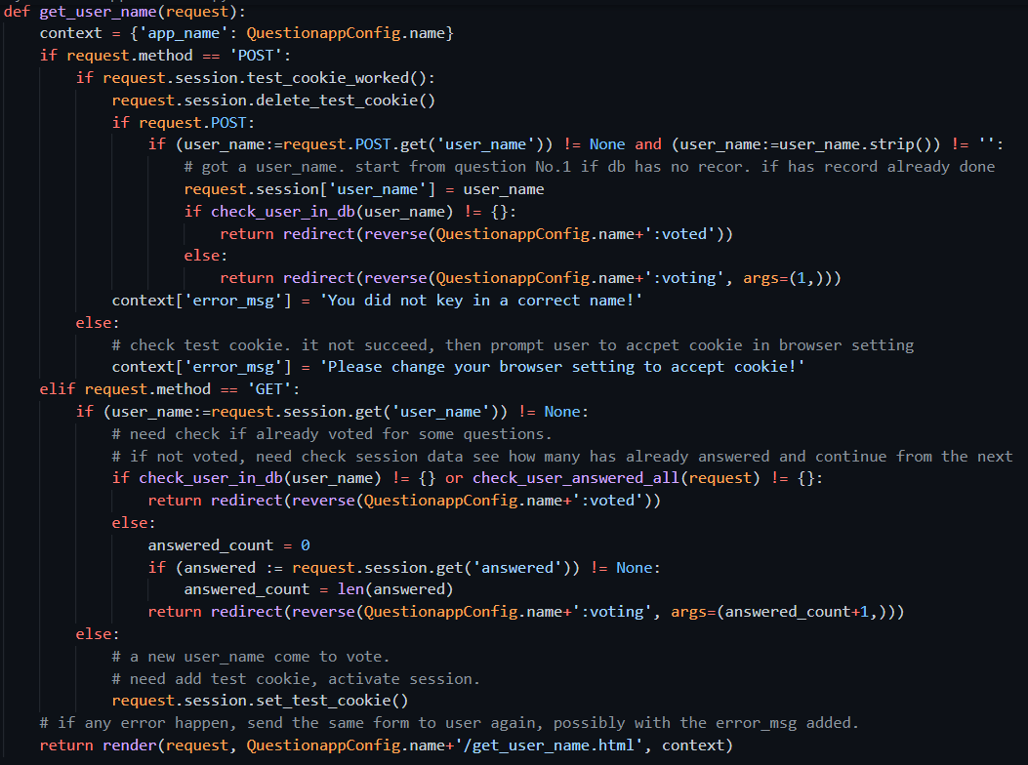
Get_user_name view
QuestionApp/views.py, add new view function

Slide 8
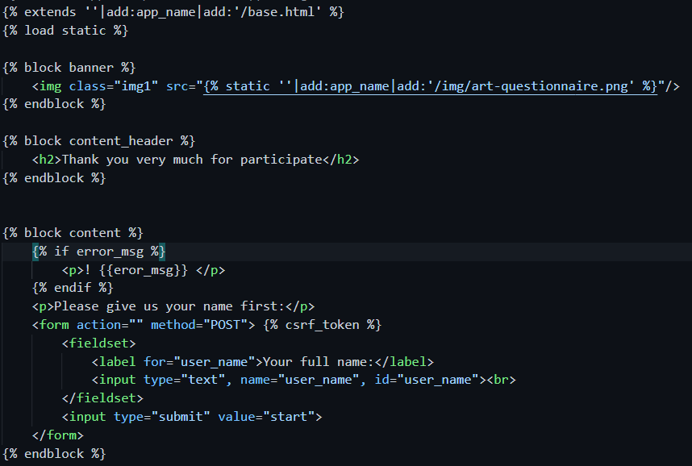
Get_user_name template
QuestionApp/template/QuestioApp/, add new template file

Slide 9
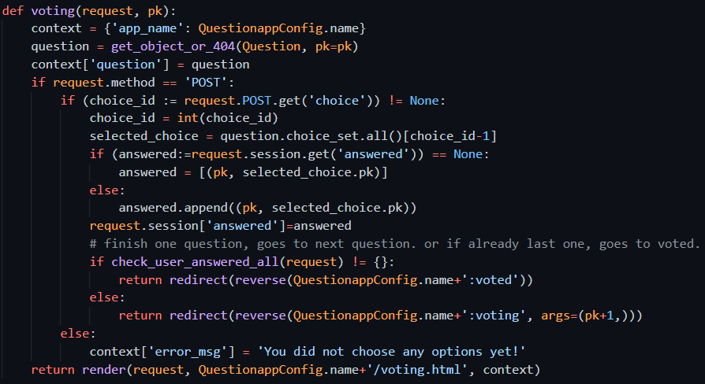
Voting view
QuestionApp/views.py, add new view function

Slide 10
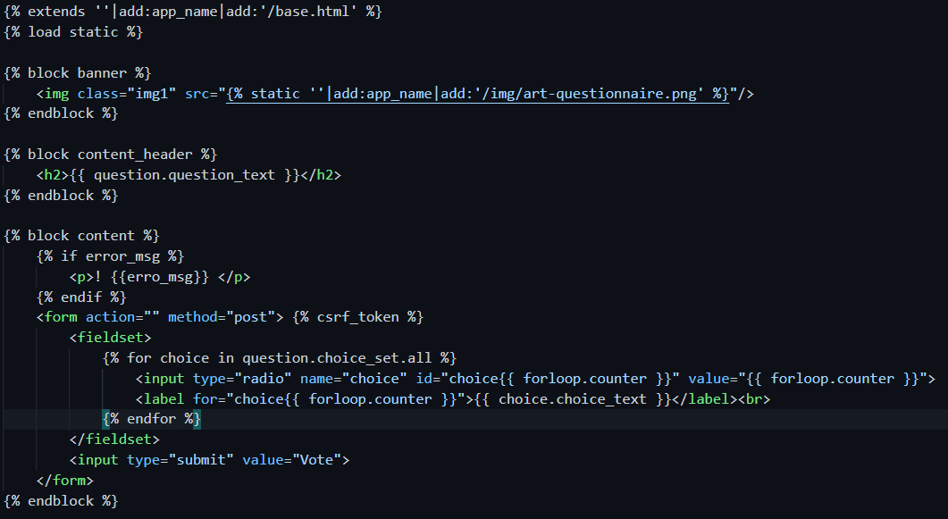
Voting template
QuestionApp/template/QuestioApp/, add new template file

Slide 11
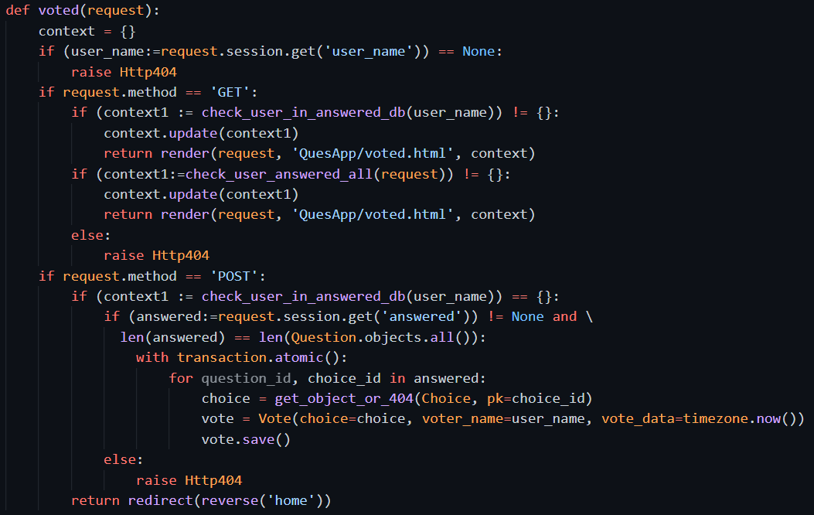
Voted view
QuestionApp/views.py, add new view function

Slide 12
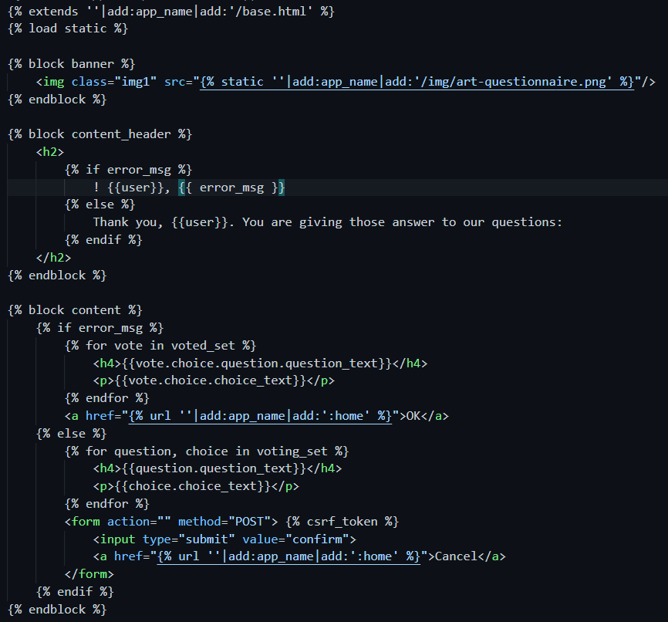
Voted template
QuestionApp/template/QuestioApp/, add new template file

Slide 13
Push to repo, deploy to Heroku cloud
PS> cd QuestionPrj
PS> git status
PS> git add –A
PS> git commit –m “add static files deploy”
PS> git push origin main
PS> git push heroku main
PS> heroku ps:scale web=1

Slide 14
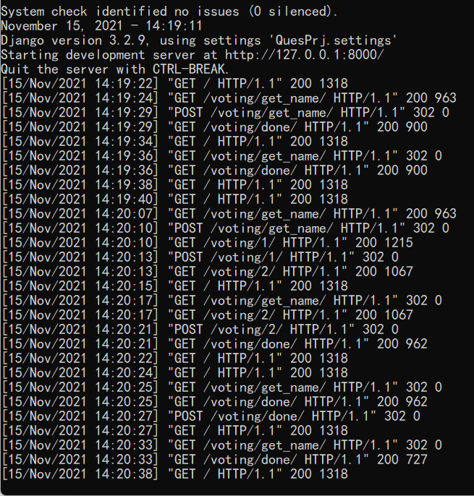
Check the process
A user already answer all question, but come try do it again, out web site respond with the previous answer and finally back to home
A user start answer questions partially, then click to other pages.
Then start answer again, will start from the question which he had stopped.

Slide 15
Other function
If allow user to make change to any of the question when final step showing all the answered have done, how to make the change?
If cancel at the final step, then start again from homepage, all the previous answer still there. If want to start all from start again, how?
After user already submit and recorded into DBMS, allow user to withdraw the submitted result? Allow make a new one?

